Slide 1
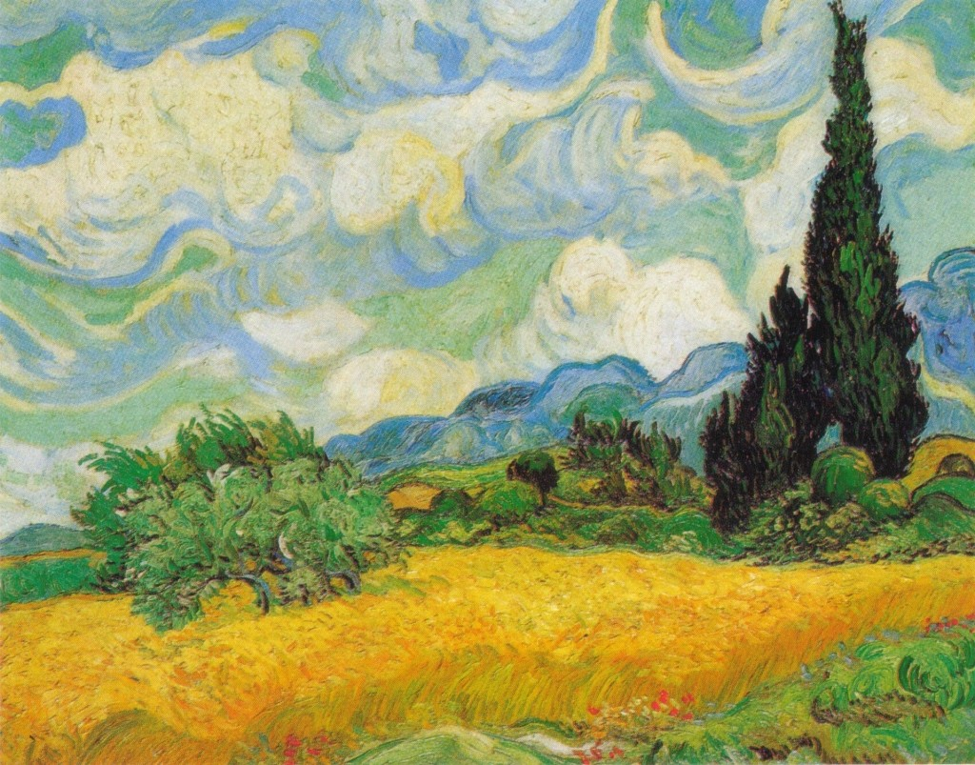
Other Plant Hormones

Slide 2
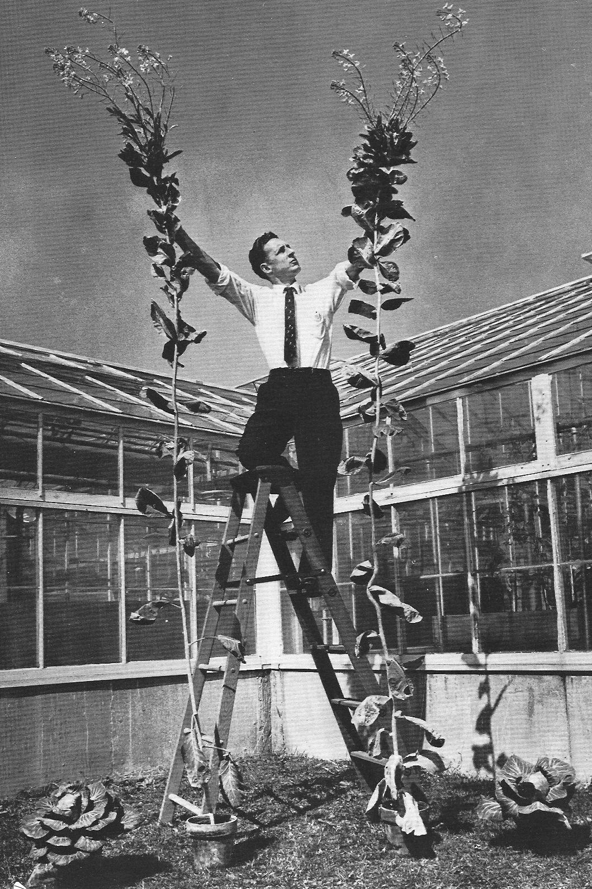
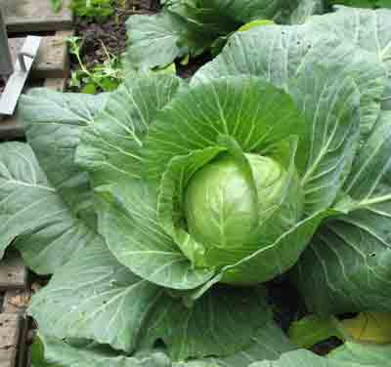
Gibberellins
Here are some cabbages
Their breeder, Sylvan H. Wittwer (the guy on the ladder) treated them with gibberellin.
A normal cabbage looks more like this

Slide 3
Gibberellins
Example: gibberellic acid
Hormones produced in growing tips.
Cause rapid elongation of internodes (= stem between leaves)
Involved in seed germination and breaking bud and seed dormancy.

Slide 4
Cytokinins
Made in roots.
Keep root and shoot growth in balance
Together with auxin, stimulates cell division.
Slows aging of plant.
Also made in young fruit to promote growth

Slide 5
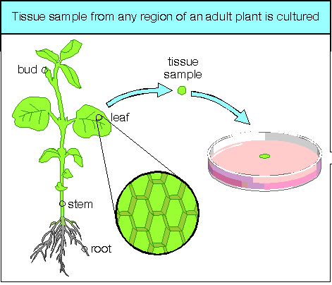
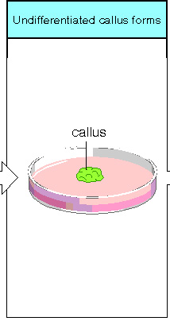
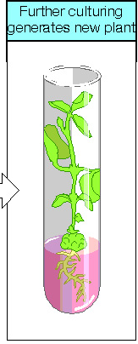
Tissue Culture

Slide 6
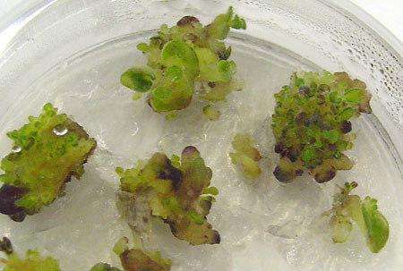
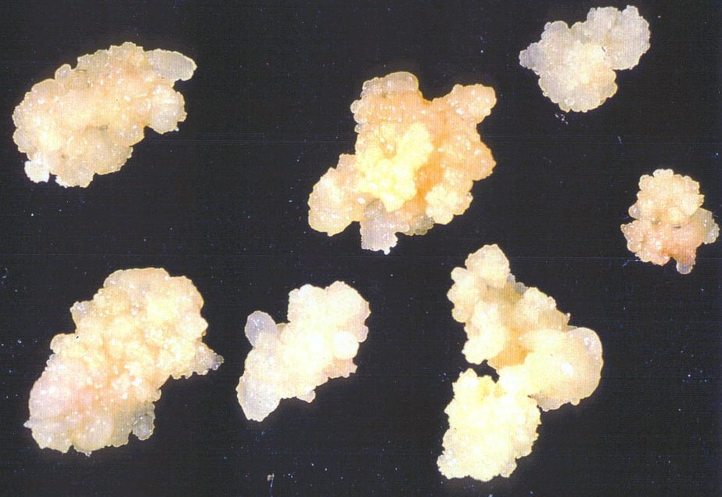
Plant Callus cultures
African violet and onions

Slide 7
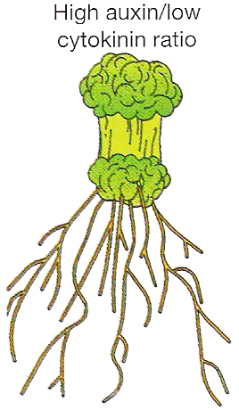
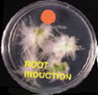
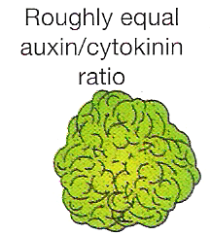
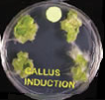
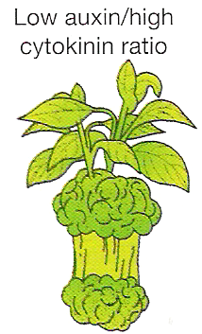
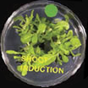
Auxin/cytokinin ratio effect on tissue culture

Slide 8

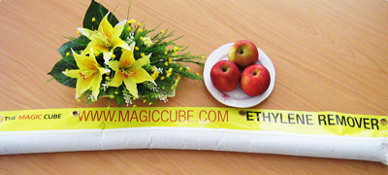
Ethene (ethylene)
Made in ripening fruit and in old leaves
Causes fruit to ripen, and petals and leaves to fall
Used commercially to ripen fruit – e.g. bananas.
Removing it allows fruit and flowers to last longer

Slide 9
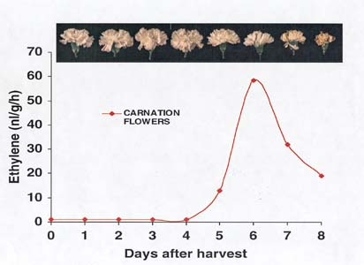

Slide 10
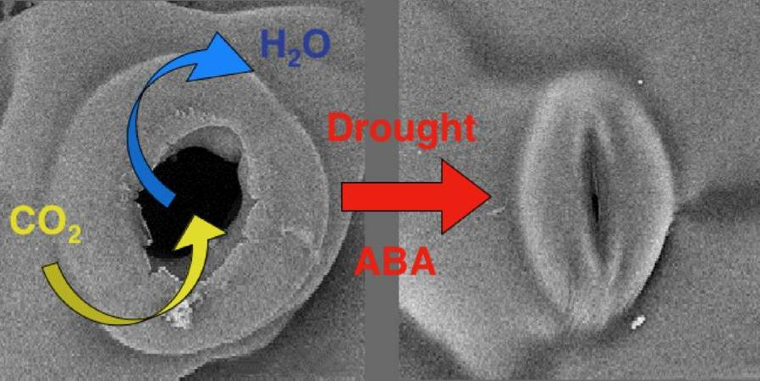
Abscisic acid ABA
Made in stressed or older leaves
Growth inhibitor
Involved in
  fruit fall and leaf fall
  dormancy of some seeds
  stomatal closing to conserve water

Slide 11
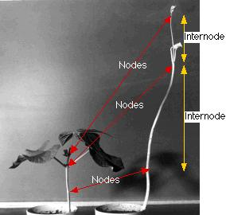
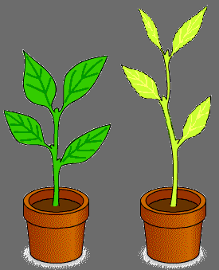
Etiolation
Plants grown in dim light become etiolated
Long internodes and small yellow leaves

